Slide 1

Deep Learning Techniques for Gesture Recognition: Where to Split the Complexity
Matteo Drago, Riccardo Lincetto
Dept. of Information Engineering, University of Padova, Italy
Prof. Michele Rossi
matteo.drago@studenti.unipd.it
riccardo.lincetto@studenti.unipd.it
September, 5, 2018

Slide 2
Outline
Introduction
Dataset description
Related Work
Our proposal
Discussion of results
Conclusion and future works

Slide 3
Introduction
Human Activity Recognition:
Visual detection from images and video
Gesture recognition from sensor-based data
In the past decade, many models have been designed for time series classification.
Main problem:
LACK of BENCHMARKING DATASET to compare different solutions
ABSENCE of DETAILS in most of the models presented in the literature

Slide 4
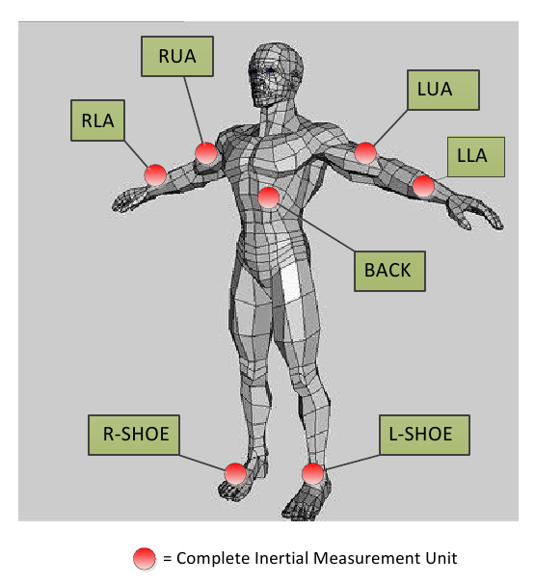
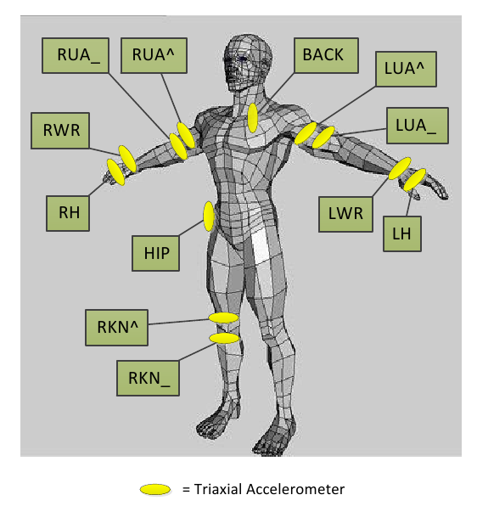
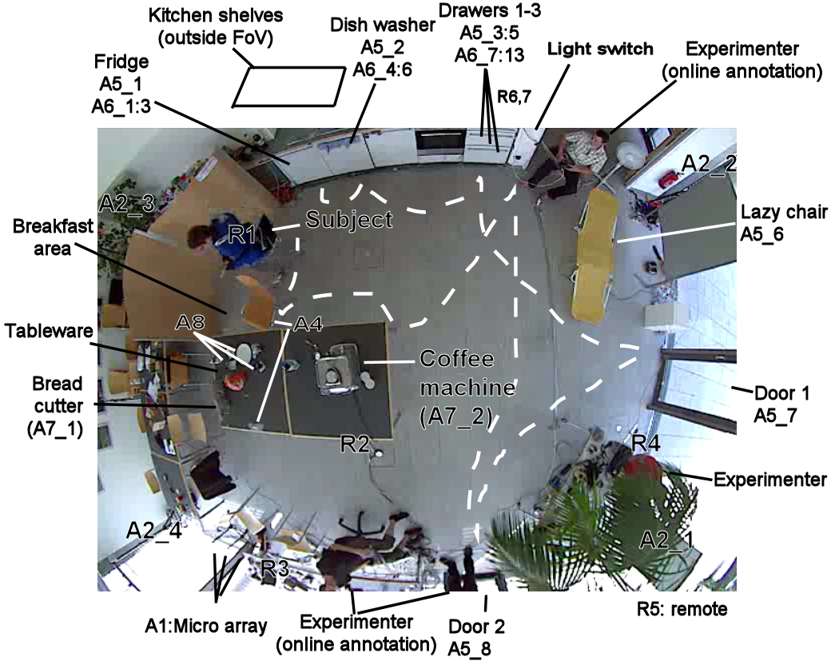
OPPORTUNITY DATASET
[1] R. Chavarriaga, H. Sagha, A. Calatroni, S. T. Digumarti, G. Tröster, J. del R. Millán, and D. Roggen, “The opportunity challenge: A benchmark database for on-body sensor-based activity recognition,” Pattern Recognition Letters, 2013.

Slide 5
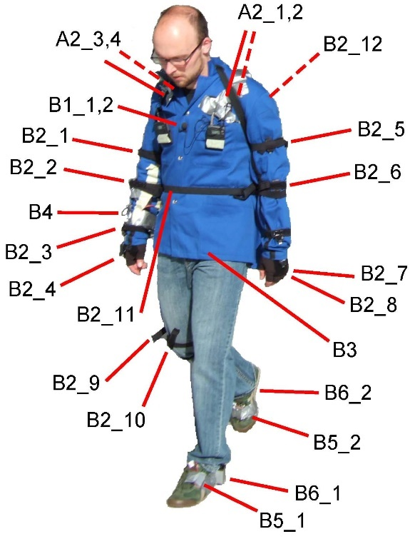
4 different subjects
7 Inertial Measurement Units
12 accelerometer sensors
113 channels of measurements
Data has been collected in two distinct modalities :
5 sessions of Activity of Daily Living (ADL)
Drill : 20 repetitions of low level activities

Slide 6
Multiclass Classification Problem
TASK A:
Classification of high level gestures / modes of locomotion
Standing, Walking, Lying, Sitting
TASK B:
Recognition of low level gestures (17 in total)
Open Dishwasher, Close Dishwasher, Open Fridge, Close Fridge,
Open Drawer 1, Close Drawer 1, Open Door 1, Close Door 1, …
Both tasks comprehend the Null Class, which represents inactivity.
A more detailed discussion on this in a couple of slides

Slide 7
State of the Art

Slide 8
Conclusions
First step
Second step
Third step
Fourth step

Slide 9
Deep Learning Techniques for Gesture Recognition: Where to Split the Complexity
Matteo Drago, Riccardo Lincetto
Dept. of Information Engineering, University of Padova, Italy
Prof. Michele Rossi
matteo.drago@studenti.unipd.it
riccardo.lincetto@studenti.unipd.it
September, 5, 2018

